Slide 1


Infections induced HUS
a comprehensive diagnostic & therapeutic approach
Michal Malina
Consultant Paediatric Nephrologist
National Renal Complement Therapeutics Service
http://www.atypicalhus.co.uk/
@DrMalinaM

Slide 2
Overview
What is HUS
HUS history
Shigatoxin caused HUS (STEC)
Other infections causing HUS
Pneumococcal HUS (pHUS)
Viral induced

Slide 3






Thrombotic microangiopathies
Primary TMA hereditary
cblC deficiency mediated TMA
Primary TMA acquired
TTP with ADAMTS13 mutation
DGKE
TMA
aHUS with FH autoantibody
TTP with ADAMTS13
autoantibody
aHUS with complement gene mutation
Unexplained
Pregnancy associated TMA
De novo TMA after solid organ transplant
TMA
Secondary TMAs
Other
infections
HELLP
TMA with severe hypertension
CAPS
TMA after bone marrow transplant
TMA with autoimmune
conditions
HIV
associated TMA
SRC
Pneumococcal HUS
SLE
AAV
IgAN
Drug induced TMA
MN
TMA with glomerular diseases
Infection associated TMAs
Brocklebank V, Thrombotic Microangiopathy and the Kidney. Clin J Am Soc Nephrol. 2018 - edited
FSGS
Malignancy
associated TMA
STEC
HUS
C3G/MPGN

Slide 4


HUS
Low platelets, haemolytic anaemia, high LDH, negative DAT, high reticulocytes
Acute Kidney Injury
yndrome
Malina, M., Fremeaux-Bacchi, V., Johnson, S. (2023). Atypical Hemolytic Uremic Syndrome. In: Schaefer, F., Greenbaum, L.A. (eds) Pediatric Kidney Disease.

Slide 5
1955 - HUS

Slide 6
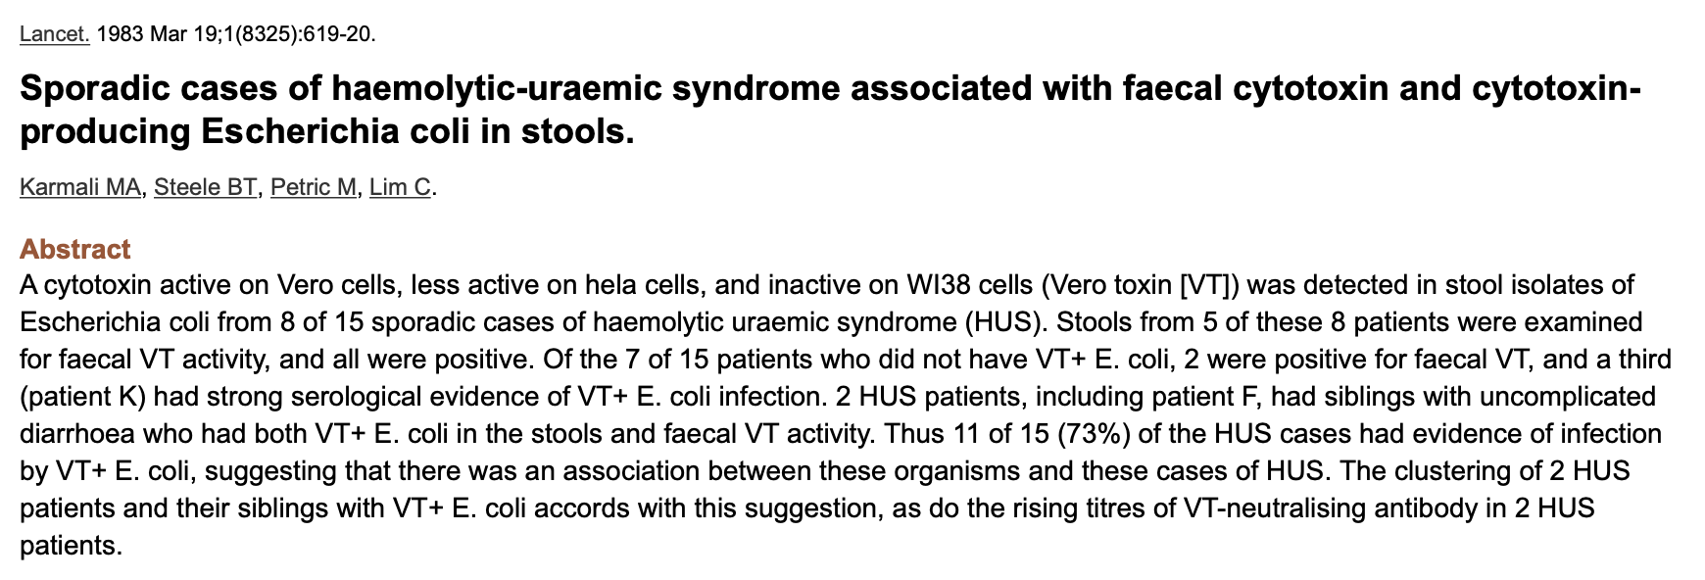
1983 – E. coli toxin association

Slide 7
Shiga toxin associated HUS (STEC HUS)

Slide 8
Incidence and Epidemiology
1.7 cases/100,000 person year (EU)
ages 1 to 4 years incidence of 6.0 cases / 100,000 person year
Highest incidence in Argentina with 7.25-17 / 100,000 person year
Seasonal peak in summer in Europe
ECDC ECDC surveillance report. Surveillance of
seven priorities food-and waterborne diseases in the
EU/EEA

Slide 9
STEC (formerly VTEC) are a sub-group of E.coli that can secrete shiga toxin
Commonest serotype associated with human disease is O157
Notes:
1983

Slide 10


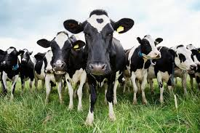
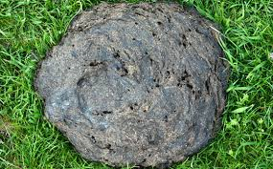
Prevalence of STEC O157:H7 in UK cattle
Herd-level prevalence rate (mean, 95% CI)
0·236 (0·166–0·325) Scotland
0·213 (0·156–0·283) England and Wales
Pat-level prevalence rate (mean, 95% CI)
0·106 (0·067–0·163) Scotland
0·069 (0·044–0·107) England and Wales
Seasonal variation in infection
Contaminated food, water, direct contact with infected animals and humans
Henry et al. Epidemiol Infect 2017

Slide 11
STX cell injury mechanism
Reproduced from Kavanagh D, Sheerin N. Thrombotic microangiopathy. In: Yu ASL, Chertow GM, Luyckx VA, Marsden PA, Skorecki K, Taar MW, editors. Brenner & Recctor’s the Kidney. 11th ed. 1178–95.

Slide 12
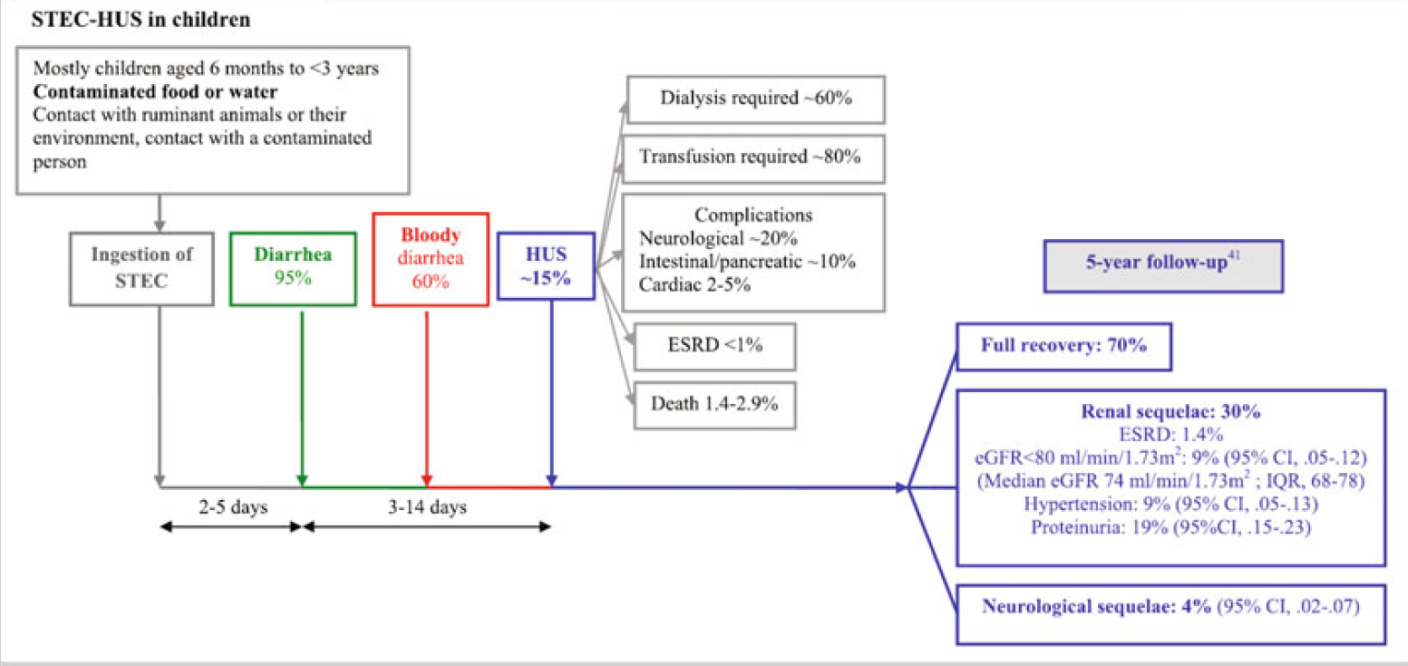
Clinical course

Slide 13

HUS
Stool culture
STEC (stx1, stx2) PCR
Low platelets, haemolytic anaemia
high LDH
negative DAT
high reticulocytes
STEC infection
Acute Kidney Injury
Symptomatic

Slide 14
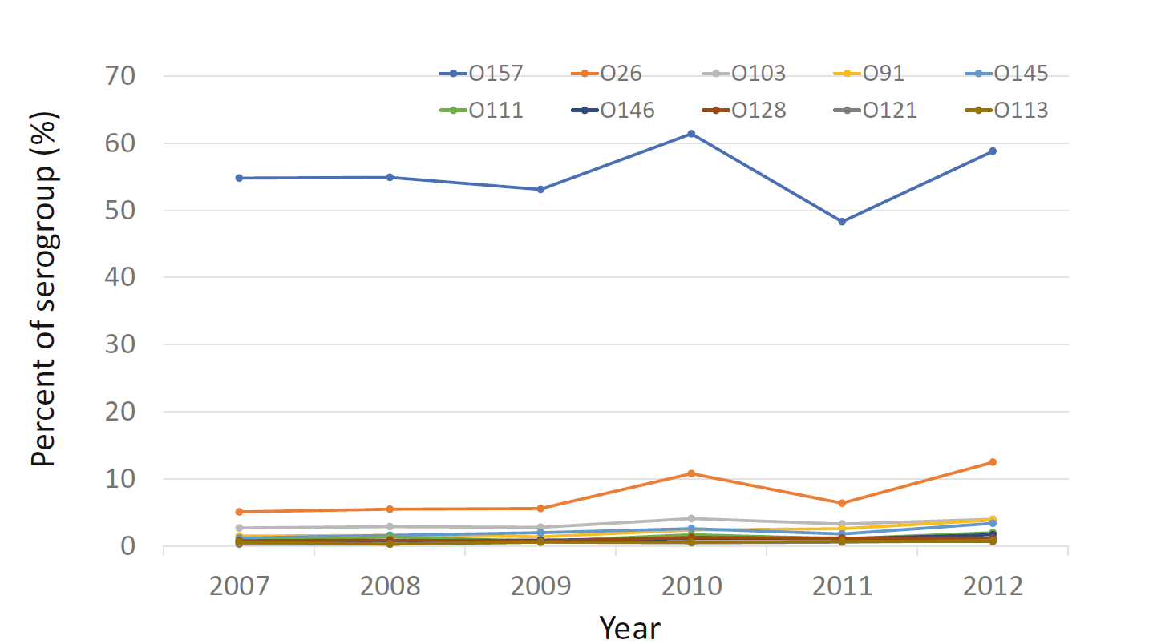
Diagnostic
Stool culture
STEC (stx1, stx2) PCR

Slide 15
Treatment of STEC HUS
Fluid management
volume expansion using isotonic solution reduces severe HUS symptoms
clinically dehydrated patients had an OR of death of 3.71 (95% CI, 1.25–11.03) and that intravenous fluid administration up to the day of HUS diagnosis was associated with a decreased risk of renal replacement therapy (OR 0.26 [95% CI, 0.11–0.60])
Grisaru S, et al Association between hydration status, intravenous fluid administration,
and outcomes of patients infected with Shiga toxin-producing Escherichia coli: a systematic review
and meta-analysis. JAMA Pediatr. 2017;171:68–76

Slide 16
Treatment of STEC HUS
Antibiotics
In vitro lead to increase of STX production and release
beta-lactams and trimethoprim/sulfamethoxazole negative
fosfomycin and fluoroquinolones some benefit
weighed on individual risk and benefit for the patient
Platelets transfusion
platelet infusion should be weighted based on individual patient risks of bleeding.
Anaemia management
hemoglobin of 70 g/L, based on severity symptoms of aneamia
Blood pressure control
Infection-Related Hemolytic Uremic,
Syndrome (HUS), Shoji Kagami, Muller Dominik, Michal Malina, and Akira Ashida

Slide 17
Possibilities for future therapies
Shiga toxin binding
Urtoxazumab
GB3 receptor saturation
Synsorb Pkb
Carbohydrate ligands, nanoparticles
Inflammation and immunomodulation
Eculizumab
Steroid treatment, IVIG, and anticoagulation
Plasma infusion, plasma exchange, and immunoadsorption
Intracellular interference

Slide 18
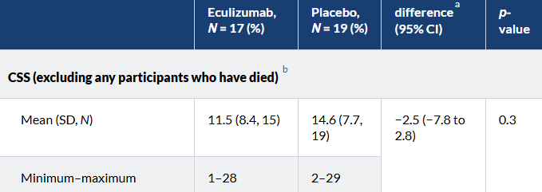
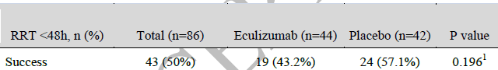
Eculizumab and STEC
ECUSTEC
ECULISHU
The rate of RRT <48 hours did not differ
similar hematologic evolution and extrarenal manifestations
Eculizumab treatment does not appear to be associated with improved renal outcome during acute phase of the disease but may reduce long-term kidney sequelae.
No conclusions can be drawn about the efficacy of eculizumab in STEC HUS from the ECUSTEC trial, and so unfortunately, the data are unable to inform clinical practice.
Efficacy and Safety of Eculizumab in Pediatric Patients Affected by Shiga Toxin–Related Hemolytic and Uremic Syndrome: A Randomized, Placebo-Controlled Trial Arnaud Garnier et al., JASN,
Efficacy and safety of eculizumab in children with Shiga-toxin-producing Escherichia coli haemolytic uraemic syndrome: the ECUSTEC RCT | NIHR Journals Library

Slide 19
Future therapies ?
Shiga toxin binding
Urtoxazumab
GB3 receptor saturation
Synsorb Pkb
Carbohydrate ligands, nanoparticles
Inflammation and immunomodulation
Eculizumab
Steroid treatment, IVIG, and anticoagulation
Plasma infusion, plasma exchange, and immunoadsorption
Intracellular interference

Slide 20
Pneumococcal HUS
The Streptococcus pneumoniae-associated HUS (pHUS)
4–5% of total HUS
annual incidence is estimated to be 0.015 to 0.06 per 100,000 children
Invasive pneumococcal disease (IPD)
septicemia, meningitis and complicated pneumonia.
Incidence of IPD has decreased with vaccine programmes but incidence of pHUS has increased

Slide 21
Pneumococcal HUS
Pathophysiology
Invasive pneumococcal infection
Bacterial neuraminidase cleave sialic acid from glycoproteins
Exposure of the normally hidden Thomsen-
Friedenreich Antigen (T-Antigen, Galß1-3GalNac)
Downstream immune mechanisms then damage or
destroy T antigen-expressing cells (RBC, endothelial
cells), leading finally to TMA and MAHA.

Slide 22

HUS
Pneumococci microbiology
DAT +
T antigen
Low platelets, haemolytic anaemia
high LDH
negative DAT
high reticulocytes
Pneumococci infection related
Treatment of primary condition (antibiotics)
Acute Kidney Injury

Slide 23
Other pathogens
Shigella
Viral infections
500 cases of HUS in shigellosis
Manifestations of HUS develop late
Incidence of HUS in 13%
post-HUS mortality of 36%
Appropriate antimicrobial treatment
Cases of HUS with influenza A and B ( neuraminidase?)
Adenovirus
HIV, cytomegalovirus, HHV6, parvovirus B19

Slide 24
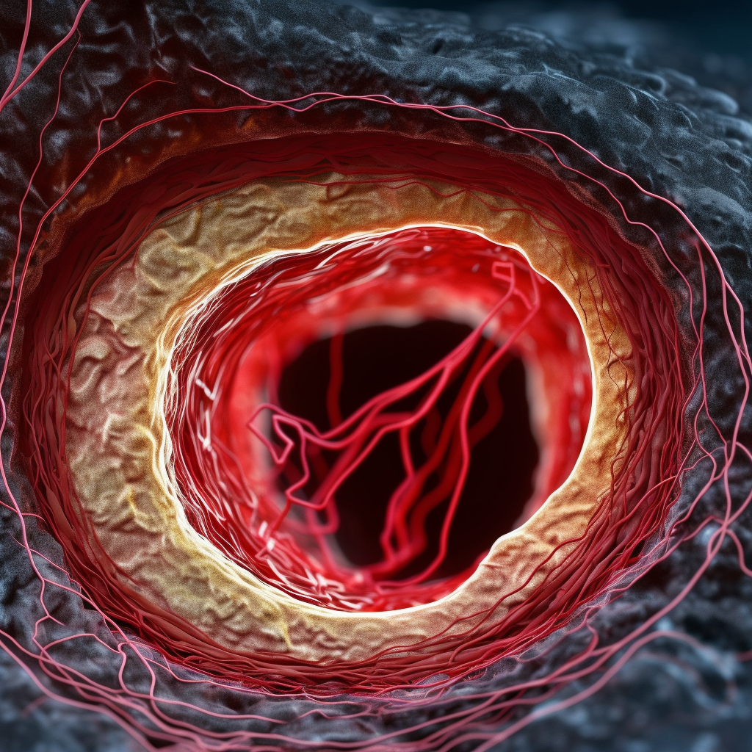
Microangiopathies
A score of 5 or higher is compatible with DIC
Presence of an underlying disorder known to be associated with DIC
(no=0, yes=2)
Coagulation results
Platelet count (> 100k = 0 < 100k = 1, < 50k = 2)
Fibrin degradation products such as D-Dimer (no increase = 0, moderate increase = 2, strong increase = 3)
Prolonged prothrombin time (< 3 sec = 0, > 3 sec = 1, > 6 sec = 2)
Fibrinogen level (> 1.0g/L = 0; < 1.0g/L = 1
Intravascular RBC fragmentation that produces schistocytes on the peripheral blood
DIC
Activation of the coagulation system
Sepsis
Trauma
Malignancy
Pregnancy
hemolysis is not a major feature of the disorder.

Slide 25


National Renal Complement Therapeutics Service

